Slide 1
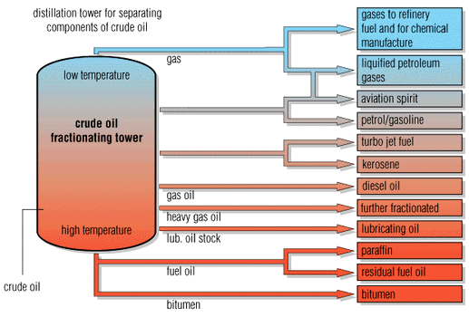
Energy in Chemistry
OCR Module 5
W Richards
Worthing High School

Slide 2
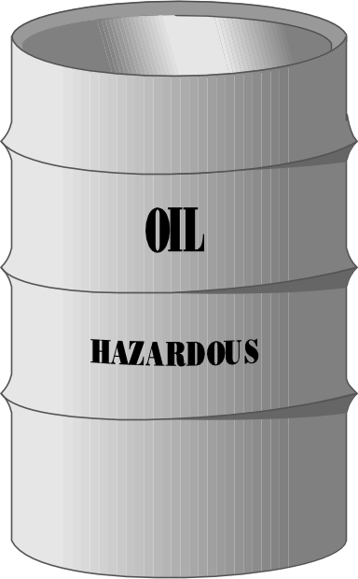
Hydrocarbons and crude oil
Crude oil is a mixture of HYDROCARBONS (compounds made up of carbon and hydrogen). Some examples:
H
H
H
C
C
H
H
H
Ethane
Increasing length
H
H
H
H
H
C
C
C
C
H
H
H
H
H
Butane

Slide 3
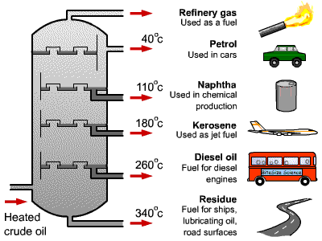
Fractional distillation
Crude oil can be separated by fractional distillation. The oil is evaporated and the hydrocarbon chains of different lengths condense at different temperatures:
Fractions with low boiling points condense at the top
Fractions with high boiling points condense at the bottom

Slide 4
Alkanes
Alkanes are SATURATED HYDROCARBONS. What does this mean?
  HYDROCARBONS are molecules that are made up of hydrogen and carbon atoms
  SATURATED means that all of these atoms are held together by single covalent bonds, for example:
Ethane
Butane
Alkanes are fairly unreactive (but they do burn well).

Slide 5
Forces between molecules
Each of these atoms is held together by a _______ covalent bond, and a chemical ________ is needed to break these bonds.
There are also forces between different molecules – these are called “__________ forces” and they’re quite _____. You don’t need a chemical reaction to break them.
The longer the hydrocarbon chain the more they are “in contact” with each other so the forces are ________.
Words – weak, strong, stronger, intermolecular, reaction

Slide 6
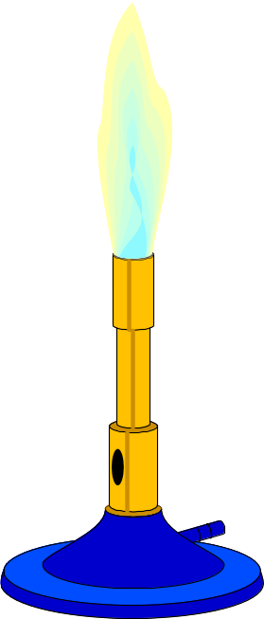
Separating hydrocarbons
When hydrocarbons are heated they move faster until the intermolecular forces are broken. The stronger the intermolecular forces the more heat is needed:
Ethane – boiling point -89⁰C
Hexane – boiling point 98⁰C

Slide 7

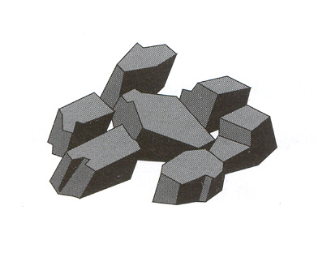
Fuels
A “fuel” is something that can be burned to release heat and light energy. The main examples are:
Oil is the most important because we get petrol, diesel, cooking gas etc from it.

Slide 8
Factors to consider when choosing a fuel
Which fuel?

Slide 9
Burning Fuels
H
H
O
O
Lots of oxygen:
O
O
H
H
C
C
H
O
H
O
O
H
O
H
Methane
+
Oxygen
Carbon dioxide
+
Water
H
H
O
H
H
O
C
O
O
H
C
H
O
H
Some oxygen:
H
O
O
H
H
O
H
O
H
C
C
O
H
O
H
O
H
H
Methane
+
Oxygen
Carbon monoxide
+
Water
H
H
O
H
Little oxygen:
H
C
O
C
H
O
H
O
H
H
Methane
+
Oxygen
Carbon
+
Water

Slide 10
The Atmosphere
Present day atmosphere contains 78% nitrogen, 21% oxygen, 1% noble gases and about 0.03% CO₂
Until recently there have been two main chemical processes responsible for keeping the balance:
Respiration
An exothermic reaction – energy is GIVEN OUT
Glucose + oxygen carbon dioxide + water
An endothermic reaction – energy is TAKEN IN
Photosynthesis:
Carbon dioxide + water Glucose + oxygen
Unfortunately, this balance is being upset by 3 things:
Excessive burning of fossil fuels
Large scale deforestation
Increase on world population

Slide 11
Evolution of the Earth’s Atmosphere
Carbon
Methane
Ammonia
Oxygen
Nitrogen
Others
dioxide
Present day atmosphere contains 78% nitrogen, 21% oxygen, 1% noble gases and about 0.03% CO₂
4 Billion years
3 Billion years
2 Billion years
1 Billion years
Present day

Slide 12

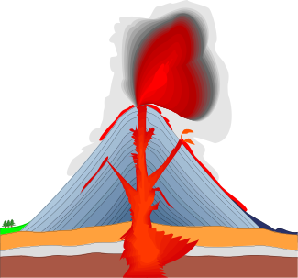


Evolution of the Earth’s Atmosphere
Volcanic activity releases CO₂, methane, ammonia and water vapour into the atmosphere. The water vapour condenses to form oceans.
Some of the oxygen is converted into ozone. The ozone layer blocks out harmful ultra-violet rays which allows for the development of new life.
4 Billion years
3 Billion years
2 Billion years
1 Billion years
Present day
Green plants evolve which take in CO₂ and give out oxygen. Carbon from CO₂ becomes locked up in sedimentary rocks as carbonates and fossil fuels. Methane and ammonia react with the oxygen and nitrogen is released. Nitrogen is also produced as a result of denitrifying bacteria on nitrates from decaying plants.

Slide 13
Endothermic and exothermic reactions
Step 1: Energy must be SUPPLIED to break bonds:
Energy
Step 2: Energy is RELEASED when new bonds are made:
Energy
A reaction is EXOTHERMIC if more energy is RELEASED then SUPPLIED. If more energy is SUPPLIED then is RELEASED then the reaction is ENDOTHERMIC

Slide 14
Burning Methane
CH₄ + 2O₂ 2H₂O + CO₂
To burn methane you have to break all of these bonds:
And then you have to make these ones:

Slide 15
Burning Methane
CH₄ + 2O₂ 2H₂O + CO₂
Methane
Oxygen
Water
Carbon dioxide

Slide 16
Bond energies
C-H = 435 Kj
O=O = 497 Kj
Total for breaking bonds (ΔH) = 4x435 + 2x497 = +2734 KJ/mol
C=O = 803 Kj
H-O = 464 Kj
Total for making bonds (ΔH) = 2x803 + 4x464 = -3462 KJ/mol
Total energy change (ΔH) = 2734-3462 = -728 KJ/mol

Slide 17

Energy from fuels
Copper calorimeter
Water
Spirit burner
Fuel

Slide 18
Experimental values
Step 1: Calculate the energy gained by the water:
Energy gained by water = mass of water x 4.18 J/gC⁰ x change in temperature
Step 2: Divide this value by the mass of the alcohol used to find out the energy gained by the water per gram of alcohol
Energy gained per gram = (answer to Step 1) / mass of alcohol burned

Slide 19
An example calculation
While doing this experiment, Dave got the following results for methanol:
Mass of water | Start temp | End temp | Temp diff | Start mass | End mass | Mass diff
100g | 16 | 51 | 35 | 159.67 | 158.22 | 1.45
Step 1: 100g x 4.18 J/gC⁰ x 35 = 14630 J
Step 2: 14630 / 1.45 = 10090 J/g
Therefore energy given out by the alcohol =
10090J/g

